Slide 1
W4111 – Introduction to Databases Section 002, Spring 2021 Lecture 2: ER, Relational, SQL (II)
© Donald F. Ferguson, 2021

Slide 2
W4111 – Introduction to Databases Section 002, Spring 2021 Lecture 2: ER, Relational, SQL (II)
We will start in a couple of minutes.
© Donald F. Ferguson, 2021

Slide 3

Contents
3 | COMS W4111_002_2021_1: Lecture 2: ER, Relational, SQL (II) © Donald F. Ferguson, 2021

Slide 4
Contents
Introduction: comments, questions and answers
Sample Problem: Harry Potter Characters (At end, and/or recitation)
ER (Diagram) Modeling (Chapter 6)
The Relational Model and Algebra (Chapter 2)
SQL

Slide 5
Questions, Answers, Comments
5 | COMS W4111_002_2021_1: Lecture 2: ER, Relational, SQL (II) © Donald F. Ferguson, 2021

Slide 6
GitHub
Demo GitHub approaches.

Slide 7
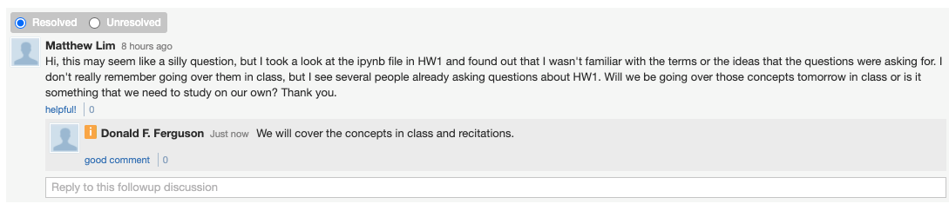
HW 0 and 1 Concepts
Learning SQL, relational algebra, ... ...
There are hundreds of online, interactive tutorials. You learn these concepts by trial, error and practice.
My approach in previous semesters has been to focus on walking through scenarios to demonstrate how to apply the concepts, solve realistic problems, best practices, ... My walking through material you can easily read is a waste of all lecture time.
Students have complained that lectures do not prepare them for homework assignments.
Well, that view demonstrates a staggering lack of understanding of the purpose of university education.
My job is to help you grow intellectually, challenge you and prepare you for your future.
The university system and processes condition the faculty and you to act like the purpose of the lectures is to determine which students get an A, B, ...
That aside, I will cover all necessary material for homework assignments in lectures and recitations.
We will sometimes publish HW assignments before covering the material. This provides information for time management.

Slide 8
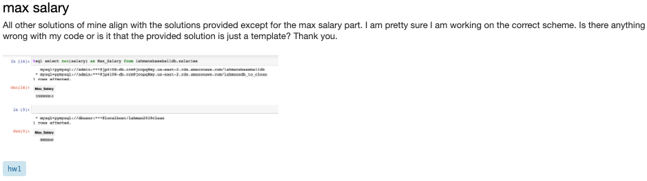
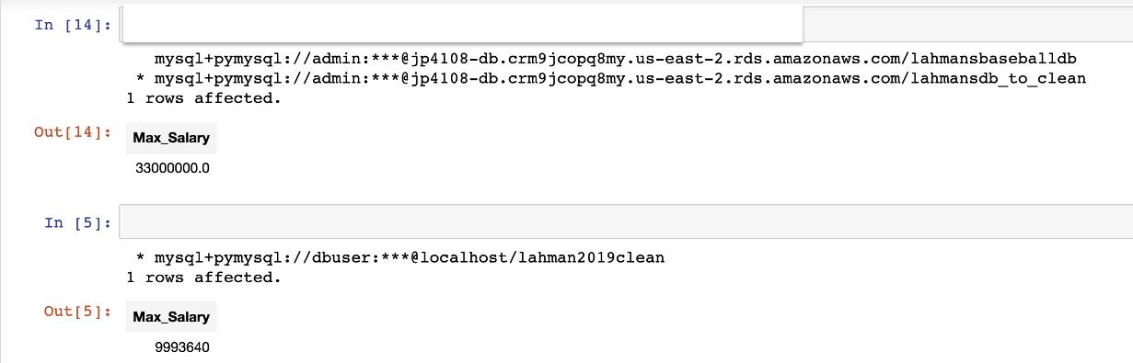
Computing Max Salary (Part D, Q0)
Student answer
Which answer is correct? Well, it depends.
Sample answer

Slide 9
What Do You Mean, “It Depends.”
In the past semesters, we required students to import CSV files for all tables. This semester, we simplified and have you a load script.
In general,
Columns in CSV files are text for import.
Importing as numbers often fails because a row contains something like “”, “NA”, ...
Maximum of salary.
If treated as text 9993640 is “bigger” than 33000000.
If treated as numbers 33000000 is “bigger” than 9993640.
For text, “>” is alphabetical order, not number value.
Consider something like ‘value1 operator value2.’ What happens? It depends on the operators and the types.
Language runtimes often implement type coercion/type conversion.

Slide 10
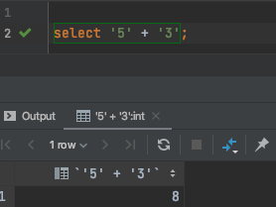
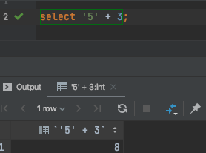
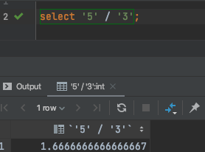
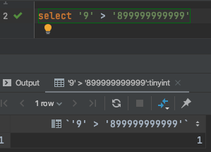
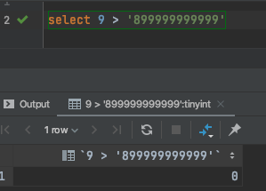
Type Coercion/Type Conversion
All languages perform coercion/conversation.
The rules are usually similar but there are differences.

Slide 11
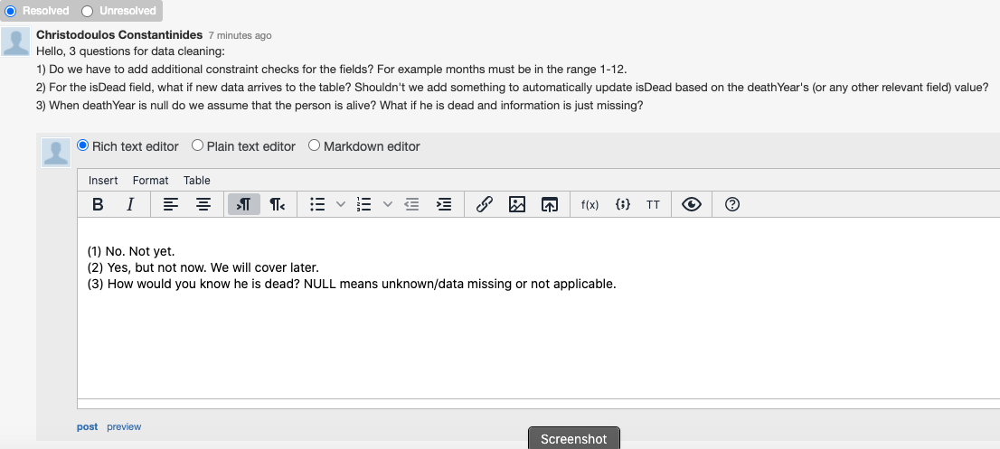
Excellent Questions

Slide 12
Codd’s 12 Rules
Rule 3: Systematic treatment of null values:
Null values (distinct from the empty character string or a string of blank characters and distinct from zero or any other number) are supported in fully relational DBMS for representing missing information and inapplicable information in a systematic way, independent of data type.
Sometimes programmers and database designers are tempted to use “special values” to indicate unknow, missing or inapplicable values.
String: “”, “NA”, “UNKNOWN”, ...
Numbers: -1, 0, -9999
Other indicators can cause confusion because you have to carefully code some SQL statements to the specific, varying choices programmers made.

Slide 13
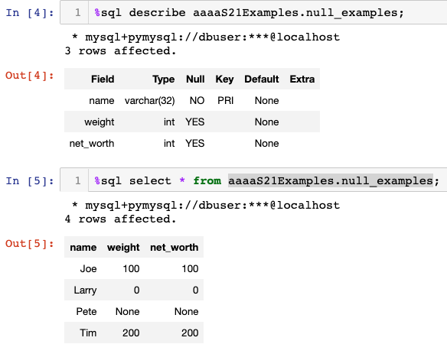
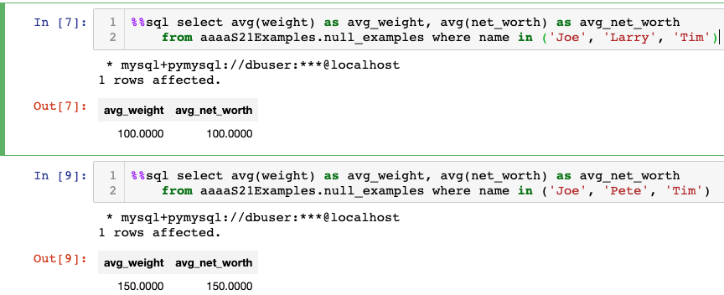
NULL and Correct Answers
Without NULL, to get a correct answer:
I must understand the domain to determine “unknown” values or know what choice a developer made.
Explicitly include “where weight != 0” in all statements.
And this varies from column to column, table to table, schema to schema, etc.

Slide 14
Back to Our Excellent Question
“When deathYear is null do we assume that the person is alive? What if he is dead and information is just missing?”
Well,
My interpretation is that if there is no death date, isDead should be NULL.
I might expect that the person is dead if their current age would be 125, but that is just a guess.
Also,
Having a column isDead is actually a bad design pattern in this case.
The value of isDead is functionally dependent on deathYear.
Database designs avoid functional dependencies to prevent update anomalies. Some could forget to update both columns when learning a fact.
In other scenarios, I might know that a person isDead but not know the deathDate. So, this design decision is problem/scenario specific.

Slide 15
Paraphrasing a Common Question
There are a lot of columns. Is there anyway to
Figure out the list of columns.
Set all values with “” to NULL in one statement.
The logic would be something like,
For c in list_of_columns(people):
If there are “” values in c then:
Update people set c=NULL where c=“”
For, If ... Then ... else, and similar language constructs are imperative or procedural.
SQL (and the relational algebra) are declarative.
for ..., if ... then ... are specifying how to compute the answer.
SQL specifies what answer you want.
So, do I have to write a lot of update statements?

Slide 16
Paraphrasing a Common Question
There are a lot of columns. Is there anyway to
Figure out the list of columns.
Set all values with “” to NULL in one statement.
The logic would be something like,
For c in list_of_columns(people):
If there are “” values in c then:
Update people set c=NULL where c=“”
For, If ... Then ... else, and similar language constructs are imperative or procedural.
SQL (and the relational algebra) are declarative.
for ..., if ... then ... are specifying how to compute the answer.
SQL specifies what answer you want.
So, do I have to write a lot of update statements?
Switch to Jupyter Notebook example (But, ... ... You spent more time trying to figure out a solution, commenting on Piazza, coming to OH, etc. then it would have taken to just do it)

Slide 17
What is the Purpose of this Question?
Clarify the distinctions between procedural and declarative (data) languages.
Using declarative terms, you are requesting a new operator:
Cool_Don_Operator people map “”=Null, “NA”=NULL
For this to work, the operator must be part of the algebra.
Because you want to perform other operators on the result.
This is a fundamental concept in the relational model/SQL model. It is an algebra that is closed under the defined operators.
We will see in module IV that there ARE environments that allow you to defined new algebraic operators to solve problems like the ”I really do not want to manually convert 47 columns ‘’ values to NULL.” You cannot appreciate the concept until you have lived without it.
And, I am trying to teach you to start thinking about the concept of attribute domains when looking at data:
Batting.AB is not really an integer. It is a domain and constraint (int, AB >= 0).
There are other examples.

Slide 18
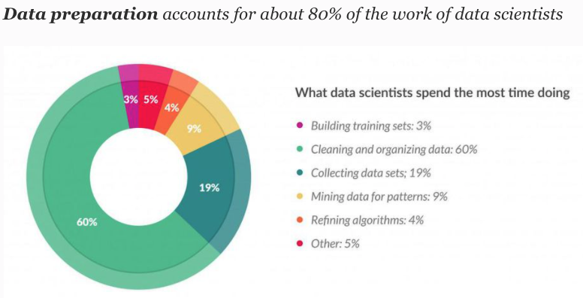
So, You Want to be a Data Scientist?
You are here.
Are you sure? Have you really thought this whole “no programming” thing through?

Slide 19
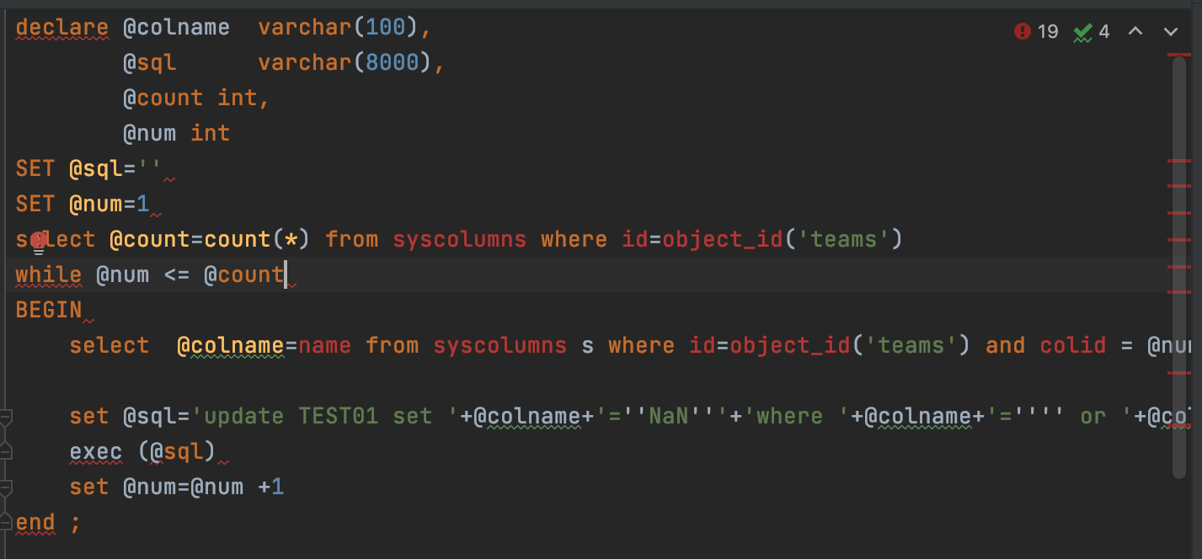
The Non-Programming Track has Programming

Slide 20
Today’s Task #1
20 | COMS W4111_002_2021_1: Lecture 2: ER, Relational, SQL (II) © Donald F. Ferguson, 2021

Slide 21
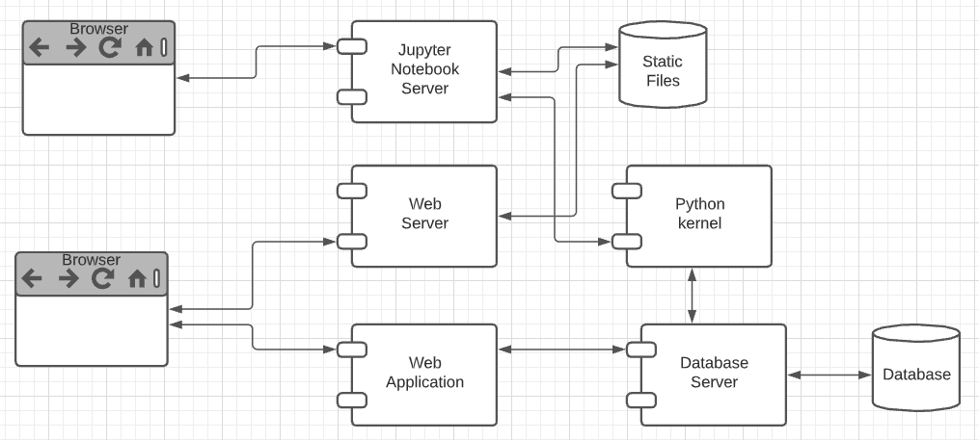
Harry Potter Character Information Application
Dataset:
https://www.kaggle.com/gulsahdemiryurek/harry-potter-dataset
Six “comma separated value (CSV)” files. We will start with Characters.csv.
Tasks: (Both tasks start with importing and engineering the data.)
Build an interactive web application for create-retrieve-update-delete entries. The application must enforce semantic integrity.
Build a Jupyter Notebook that does some interesting visualization and analysis.
Elements:
Content/applications in a browser.
Jupyter Notebook Server is both:
A web server
A (specialized) web application server.
Web server delivers HTML, images, ... to the browser.
Web application server executes an
Application server framework (Flask)
The Python code implementing the app.
The Jupyter Notebook Server runs code cells in a Python kernel.
I am mostly going to ignore the browser and content.

Slide 22

The Data – Characters.csv
15 columns:
Id
Name
Gender
Job
House
Wand
Patronus
Species
Blood status
Hair colour
Eye colour
Loyalty
Skills
Birth
Death
Downloaded the file.
The columns are separated by ‘;’
Despite being “Comma” Separated Values, other separators are common.
Loaded using DataGrip into MySQL
Connect
Create Schema
Use Schema
Use the data load tool.

Slide 23
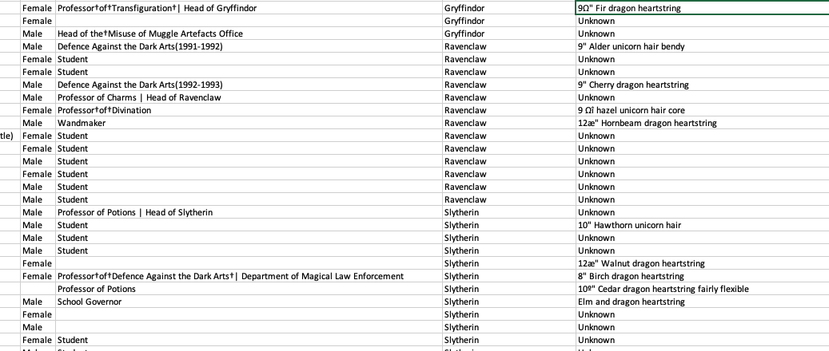
But First, Let’s Look at the Data
There are some weird characters, no pun intended.
9º" Chestnut dragon heartstring
Dumbledore's Army |Hogwarts School of Witchcraft and Wizardry
9Ω" Fir dragon heartstring
Professor†of†Transfiguration†| Head of Gryffindor
How did this happen?
What do we do?

Slide 24
Analysis (I)
Some of the issues are character encoding/set issues:
“In computing, data storage, and data transmission, character encoding is used to represent a repertoire of characters by some kind of encoding system that assigns a number to each character for digital representation.” (https://en.wikipedia.org/wiki/Character_encoding)
“A character set is a collection of characters that might be used by multiple languages.” (https://en.wikipedia.org/wiki/Character_encoding)
This will be a common issue when dealing with string data that you import to build your database.
This is especially true if the data comes from “data scraping”.
“Data scraping is a technique in which a computer program extracts data from human-readable output coming from another program.” (https://en.wikipedia.org/wiki/Data_scraping)
There are several types of scraping: screen scraping, web scraping, ... ...
That is what happened here. The data comes from web scraping a wiki page.

Slide 25
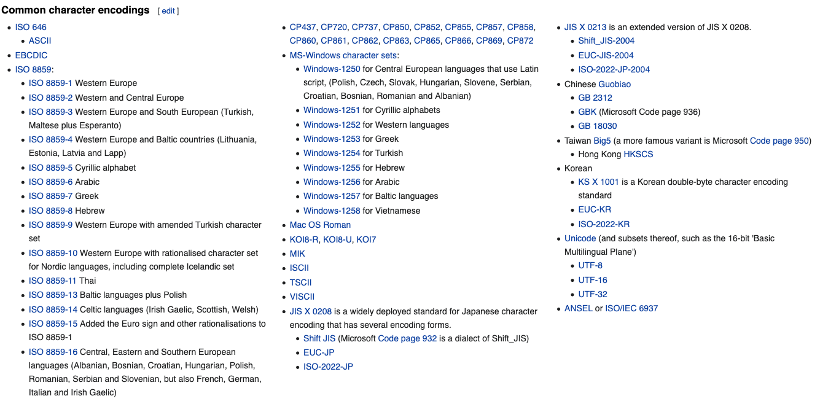
Character Encodings/Character Sets

Slide 26
Character Set Usage over Time
https://www.w3.org/International/questions/qa-who-uses-unicode

Slide 27
But, ... ...
Consider Job column entry: “Professor†of†Transfiguration†| Head of Gryffindor”
There are two odd characters: “†” and “|”
How should I correct/interpret the strings? My interpretation is:
Replace “†” with “ “.
The “|” means that the person has two jobs:
Professor of Transfiguration
Head of Gryffindor
The Job column is a multivalued attribute.
The character “|” indicates that a text string is one string containing multiple values for an attribute.
Can I always replace non-|, odd characters with “ “?
‘9Ω" Fir dragon heartstring’ and ‘9º" Chestnut dragon heartstring’ would wind up having an extra space. I want 9”, not 9 “.
The cleanup is getting complicated.

Slide 28
The Cleanup is Rule-Based
In this dataset, I can use a set of rules for data clean up:
Two characters separated by † maps to two characters separated by “ “ (space).
A number and “ separated by an odd character maps the the number and “
Strings of the form s1 | s2 | s3 maps to [s1, s2, s3]
etc.
Well, I could write a custom function for each rule,
But what happens when I find I need other rules.
It would be nice if there were some kind of tools that helps.
A regular expression is a sequence of characters that define a search pattern. Usually, such patterns are used by string-searching algorithms for "find" or "find and replace" operations on strings, or for input validation. It is a technique developed in theoretical computer science and formal language theory. (https://en.wikipedia.org/wiki/Regular_expression)

Slide 29
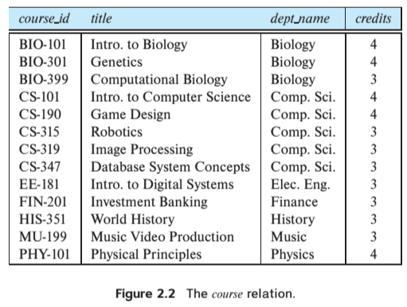
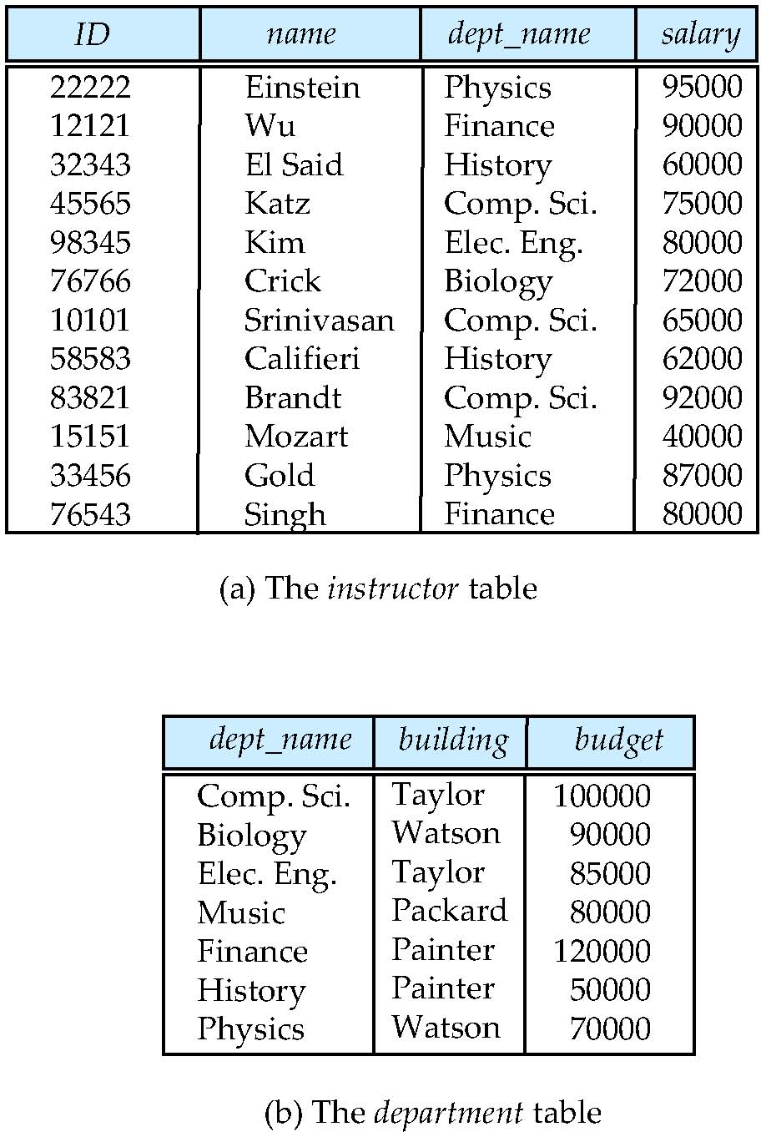
Multivalued Attributes
How about strings of the form s1 | s2 | s3 maps to [s1, s2, s3]. Is this cool?
All the data entity sets we have seen have had simple types/value attributes. Depends on the database model, e.g. relational, document, ...

Slide 30
Data Cleansing
https://blog.amplitude.com/big-data-cleanup
Database and data science classes love to teach the fun stuff queries, data modeling, machine learning, spooky math, algorithms, ... ...

Slide 31
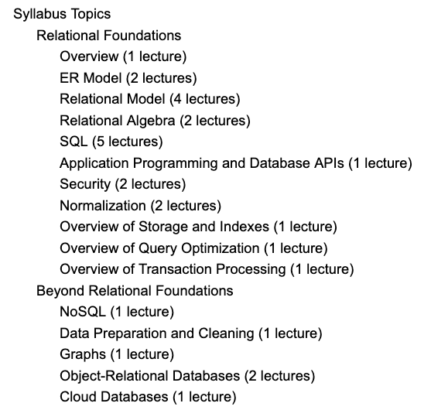
Data Cleansing
Recommended Syllabus
I place more emphasis on data cleansing and refactoring than other sections of W4111.

Slide 32
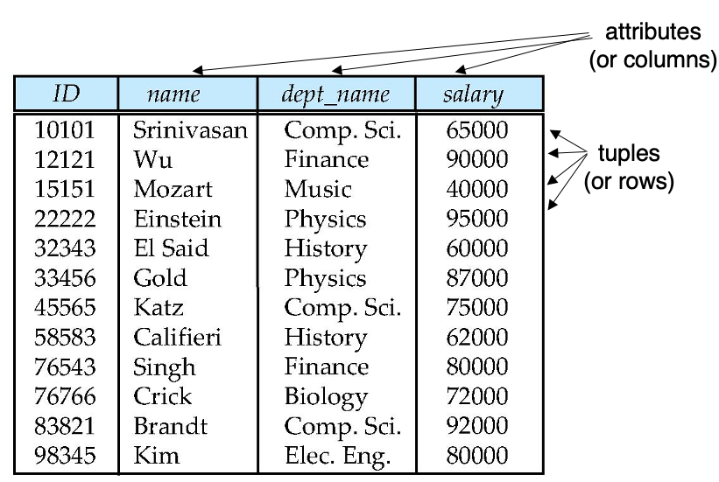
Next Steps in the Plan
Source Data
Relational Data
We are starting the semester with the relational datamodel/databases.
Before we get too far in our data janitor work, we should understand the relational model a little more.

Slide 33
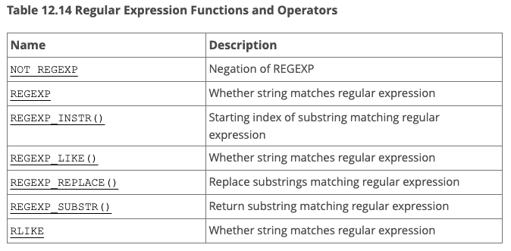
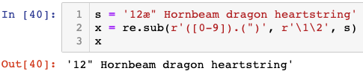
But, Before We Leave ... ...
What are these regular expressions whereout you speak?
Many environments come with regular expressions functions for searching and transforming strings.
Python: Lib/re.py (https://docs.python.org/3/library/re.html)
Java: java.util.regex (https://www.w3schools.com/java/java_regex.asp)
"SNOBOL ("StriNg Oriented and symBOlic Language") is a series of programming languages ... ... having patterns as a first-class data type.” (https://en.wikipedia.org/wiki/SNOBOL)
Most SQL databases have some from of regular expression library, but the libraries differ from product to product.
This was FYI.
Not a core part of W4111.
We will play with it a little.

Slide 34
The Relational Model
34 | COMS W4111_002_2021_1: Lecture 2: ER, Relational, SQL (II) © Donald F. Ferguson, 2021

Slide 35

The Relational Data Model
35 | COMS W4111_002_2021_1: Lecture 2: ER, Relational, SQL (II) © Donald F. Ferguson, 2021

Slide 36

Relational Model
All the data is stored in various tables.
Example of tabular data in the relational model
Columns
Ted Codd Turing Award 1981
The “relation” is the “table.”
In my big space of pieces of data. ID, name, dept_name, salary are somehow related.
This causes confusion, because the ER and other models use “relation” to mean something else.
Core concepts:
Relation
Tuple (Row)
Column (Attribute)
Rows
Notes:
36

Slide 37
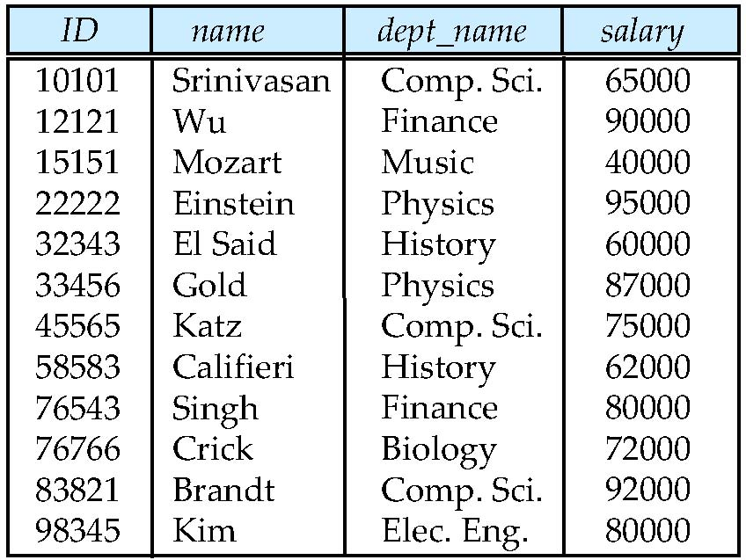
Example of a Instructor Relation
attributes
(or columns)
tuples
(or rows)

Slide 38
Attribute
The set of allowed values for each attribute is called the domain of the attribute
Attribute values are (normally) required to be atomic; that is, indivisible
The special value null is a member of every domain. Indicated that the value is “unknown”
The null value causes complications in the definition of many operations
DFF Comments:
Atomic and use of Null is important?
I will explain the importance of atomic attributes and null in examples.

Slide 39
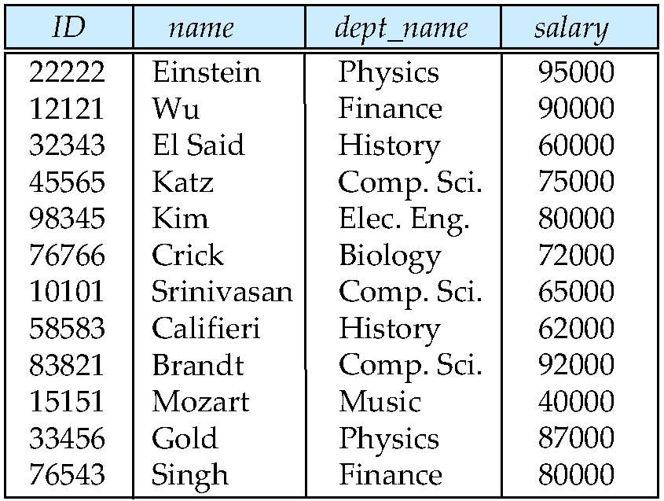
Relations are Unordered
Order of tuples is irrelevant (tuples may be stored in an arbitrary order)
Example: instructor relation with unordered tuples

Slide 40
Database Schema
Database schema -- is the logical structure of the database.
Database instance -- is a snapshot of the data in the database at a given instant in time.
Example:
schema: instructor (ID, name, dept_name, salary)
Instance:

Slide 41
Keys
Let K ⊆ R
K is a superkey of R if values for K are sufficient to identify a unique tuple of each possible relation r(R)
Example: {ID} and {ID,name} are both superkeys of instructor.
Superkey K is a candidate key if K is minimal Example: {ID} is a candidate key for Instructor
One of the candidate keys is selected to be the primary key.
which one?
Foreign key constraint: Value in one relation must appear in another
Referencing relation
Referenced relation
Example: dept_name in instructor is a foreign key from instructor referencing department

Slide 42
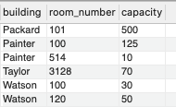
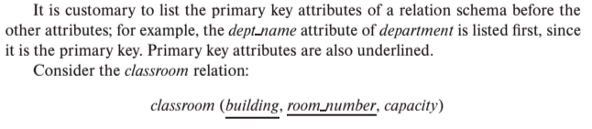
Notation
Classroom relation
classroom schema
Columns (Attributes)
Relation Name
Primary Key Columns
The primary key is a composite key. Neither column is a key (unique) by itself.
Keys are statements about all possible, valid tuples and not just the ones in the relation.
Capacity is unique in this specific data, but clearly not unique for all possible data.
In this domain, there cannot be two classrooms with the same building and room number.
Relation schema:
Underline indicates a primary key column. There is no standard way to indicate other types of key.
We will use bold to indicate foreign keys.
You will sometimes see things like classroom(building:string, room_number:number, capacity:number)

Slide 43
Observations
Keys:
Will be baffling. It takes time and experience to understand/appreciate.
There are many, many types of keys with formal definitions.
I explain the formality but focus on the concepts and applications.
No one uses the formal, relational model. So, why do we study it?
Is very helpful when understanding concepts that we cover later in the course, especially query optimization and processing.
There are many realizations of the model and algebra, and understanding the foundation helps with understanding language/engine capabilities.
The model has helped with innovating new approaches, and you may innovate in data and query models in your future.

Slide 44
Relational Algebra
44 | COMS W4111_002_2021_1: Lecture 2: ER, Relational, SQL (II) © Donald F. Ferguson, 2021

Slide 45
Relational Query Languages
Procedural versus non-procedural, or declarative
“Pure” languages:
Relational algebra
Tuple relational calculus
Domain relational calculus
The above 3 pure languages are equivalent in computing power
We will concentrate in this chapter on relational algebra
Not turning-machine equivalent
Consists of 6 basic operations
DFF Comments:
You will sometimes see other operator, e.g. ← Assignment.
Relational algebra focuses on retrieve. You can sort of do Create, Update, Delete.
The SQL Language, which we will see, extends relational algebra.

Slide 46
Relational Algebra
A procedural language consisting of a set of operations that take one or two relations as input and produce a new relation as their result.
Six basic operators
select: σ
project: ∏
union: ∪
set difference: –
Cartesian product: x
rename: ρ

Slide 47
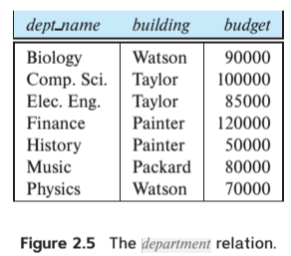
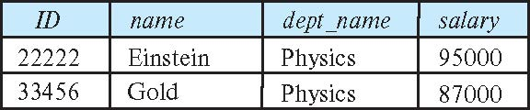
Select Operation
The select operation selects tuples that satisfy a given predicate.
Notation: σ _{p} (r)
p is called the selection predicate
Example: select those tuples of the instructor relation where the instructor is in the “Physics” department.
Query
σ _{dept_name=“Physics”} (instructor)
Result
σ _{dept_name=“Physics”} (instructor)

Slide 48
Select Operation (Cont.)
We allow comparisons using
=, ≠, >, ≥. <. ≤
in the selection predicate.
We can combine several predicates into a larger predicate by using the connectives:
∧ (and), ∨ (or), ¬ (not)
Example: Find the instructors in Physics with a salary greater $90,000, we write:
σ _{dept_name=“Physics”} ∧ _{salary} > 90,000 (instructor)
Then select predicate may include comparisons between two attributes.
Example, find all departments whose name is the same as their building name:
σ _{dept_name=building} (department)

Slide 49
Project Operation
A unary operation that returns its argument relation, with certain attributes left out.
Notation:
∏ _{A1,A2,A3 ….Ak} (r)
where A₁, A₂ are attribute names and r is a relation name.
The result is defined as the relation of k columns obtained by erasing the columns that are not listed
Duplicate rows removed from result, since relations are sets

Slide 50
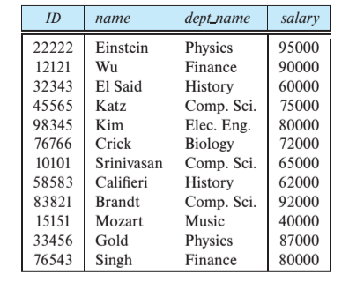
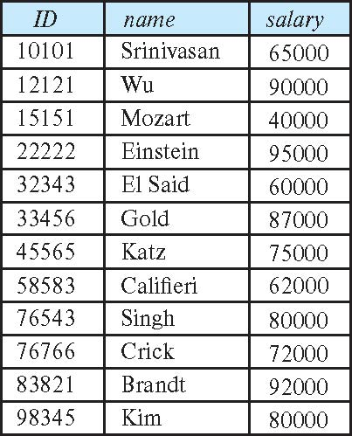
Project Operation (Cont.)
Example: eliminate the dept_name attribute of instructor
Query: ∏_{ID, name, salary} (instructor)
Result:
∏_{ID, name, salary} (instructor)

Slide 51
Composition of Relational Operations
The result of a relational-algebra operation is relation and therefore of relational-algebra operations can be composed together into a relational-algebra expression.
Consider the query -- Find the names of all instructors in the Physics department.
∏_{name}(σ _{dept_name} _{=“Physics”} (instructor))
Instead of giving the name of a relation as the argument of the projection operation, we give an expression that evaluates to a relation.

Slide 52
Relax Calculator
Let’s look at an online tool that you will use.
RelaX (https://dbis-uibk.github.io/relax/calc/local/uibk/local/0)
The calculator:
Does have the sample data from the textbook.
You can also upload new data. (Show how and example)
Some queries:
σ title='Computer Science Department' ∨ title='Accounting Division' (departments)
π last_name, email (faculty)
π last_name, email ( σ department_id=165 ∨ department_id=1010 (faculty) )

Slide 53
SQL
53 | COMS W4111_002_2021_1: Lecture 2: ER, Relational, SQL (II) © Donald F. Ferguson, 2021

Slide 54
Chapter 3: Introduction to SQL
You can think of SQL being an extended, usable, useful version of the relational model.

Slide 55
Outline
Overview of The SQL Query Language
SQL Data Definition
Basic Query Structure of SQL Queries
Additional Basic Operations
Set Operations
Null Values
Aggregate Functions
Nested Subqueries
Modification of the Database
Will cover in next lecture and/or tutorial.
Notes:
1

Slide 56
History
IBM Sequel language developed as part of System R project at the IBM San Jose Research Laboratory
Renamed Structured Query Language (SQL)
ANSI and ISO standard SQL:
SQL-86
SQL-89
SQL-92
SQL:1999 (language name became Y2K compliant!)
SQL:2003
Commercial systems offer most, if not all, SQL-92 features, plus varying feature sets from later standards and special proprietary features.
Not all examples here may work on your particular system.

Slide 57
SQL Parts
DML -- provides the ability to query information from the database and to insert tuples into, delete tuples from, and modify tuples in the database.
integrity – the DDL includes commands for specifying integrity constraints.
View definition -- The DDL includes commands for defining views.
Transaction control –includes commands for specifying the beginning and ending of transactions.
Embedded SQL and dynamic SQL -- define how SQL statements can be embedded within general-purpose programming languages.
Authorization – includes commands for specifying access rights to relations and views.

Slide 58
Data Definition Language
The SQL data-definition language (DDL) allows the specification of information about relations, including:
The schema for each relation.
The type of values associated with each attribute.
The Integrity constraints
The set of indices to be maintained for each relation.
Security and authorization information for each relation.
The physical storage structure of each relation on disk.

Slide 59
Domain Types in SQL
char(n). Fixed length character string, with user-specified length n.
varchar(n). Variable length character strings, with user-specified maximum length n.
int. Integer (a finite subset of the integers that is machine-dependent).
smallint. Small integer (a machine-dependent subset of the integer domain type).
numeric(p,d). Fixed point number, with user-specified precision of p digits, with d digits to the right of decimal point. (ex., numeric(3,1), allows 44.5 to be stores exactly, but not 444.5 or 0.32)
real, double precision. Floating point and double-precision floating point numbers, with machine-dependent precision.
float(n). Floating point number, with user-specified precision of at least n digits.
More are covered in Chapter 4.

Slide 60
Create Table Construct
An SQL relation is defined using the create table command:
create table r
(A₁ D₁, A₂ D₂, ..., A_{n} D_{n}, (integrity-constraint₁), ..., (integrity-constraint_{k}))
r is the name of the relation
each A_{i} is an attribute name in the schema of relation r
D_{i} is the data type of values in the domain of attribute A_{i}
Example:
create table instructor ( ID char(5), name varchar(20), dept_name varchar(20), salary numeric(8,2))

Slide 61
Integrity Constraints in Create Table
Types of integrity constraints
primary key (A₁, ..., A_{n} )
foreign key (A_{m}, ..., A_{n} ) references r
not null
SQL prevents any update to the database that violates an integrity constraint.
Example:
create table instructor ( ID char(5), name varchar(20) not null, dept_name varchar(20), salary numeric(8,2), primary key (ID), foreign key (dept_name) references department);

Slide 62
And a Few More Relation Definitions
create table student ( ID varchar(5), name varchar(20) not null, dept_name varchar(20), tot_cred numeric(3,0), primary key (ID),
foreign key (dept_name) references department);
create table takes ( ID varchar(5), course_id varchar(8), sec_id varchar(8), semester varchar(6), year numeric(4,0), grade varchar(2),
primary key (ID, course_id, sec_id, semester, year) ,
foreign key (ID) references student, foreign key (course_id, sec_id, semester, year) references section);

Slide 63
And more still
create table course ( course_id varchar(8), title varchar(50), dept_name varchar(20), credits numeric(2,0),
primary key (course_id),
foreign key (dept_name) references department);

Slide 64
Updates to tables
Insert
insert into instructor values ('10211', 'Smith', 'Biology', 66000);
Delete
Remove all tuples from the student relation
delete from student
Drop Table
drop table r
Alter
alter table r add A D
where A is the name of the attribute to be added to relation r and D is the domain of A.
All exiting tuples in the relation are assigned null as the value for the new attribute.
alter table r drop A
where A is the name of an attribute of relation r
Dropping of attributes not supported by many databases.

Slide 65
Basic Query Structure
A typical SQL query has the form: select A₁, A₂, ..., A_{n} from r₁, r₂, ..., r_{m} where P
A_{i} represents an attribute
R_{i} represents a relation
P is a predicate.
The result of an SQL query is a relation.
Note:
The SELECT ... FROM ... WHERE ... Combines two relational operators, σ and ∏.
Actually, it also combines other operators, e.g. x
Notes:
2

Slide 66
The select Clause
The select clause lists the attributes desired in the result of a query
corresponds to the projection operation of the relational algebra
Example: find the names of all instructors: select name from instructor
NOTE: SQL names are case insensitive (i.e., you may use upper- or lower-case letters.)
E.g., Name ≡ NAME ≡ name
Some people use upper case wherever we use bold font.
Notes:
3

Slide 67
The select Clause (Cont.)
SQL allows duplicates in relations as well as in query results.
To force the elimination of duplicates, insert the keyword distinct after select.
Find the department names of all instructors, and remove duplicates
select distinct dept_name from instructor
The keyword all specifies that duplicates should not be removed.
select all dept_name from instructor
Notes:
4

Slide 68
The select Clause (Cont.)
An asterisk in the select clause denotes “all attributes”
select * from instructor
An attribute can be a literal with no from clause
select '437'
Results is a table with one column and a single row with value “437”
Can give the column a name using:
select '437' as FOO
An attribute can be a literal with from clause
select 'A' from instructor
Result is a table with one column and N rows (number of tuples in the instructors table), each row with value “A”
Notes:
5

Slide 69
The select Clause (Cont.)
The select clause can contain arithmetic expressions involving the operation, +, –, ∗, and /, and operating on constants or attributes of tuples.
The query:
select ID, name, salary/12 from instructor
would return a relation that is the same as the instructor relation, except that the value of the attribute salary is divided by 12.
Can rename “salary/12” using the as clause:
select ID, name, salary/12 as monthly_salary
Notes:
5

Slide 70
The where Clause
The where clause specifies conditions that the result must satisfy
Corresponds to the selection predicate of the relational algebra.
To find all instructors in Comp. Sci. dept
select name from instructor where dept_name = 'Comp. Sci.'
SQL allows the use of the logical connectives and, or, and not
The operands of the logical connectives can be expressions involving the comparison operators <, <=, >, >=, =, and <>.
Comparisons can be applied to results of arithmetic expressions
To find all instructors in Comp. Sci. dept with salary > 80000
select name from instructor where dept_name = 'Comp. Sci.' and salary > 80000
Notes:
6

Slide 71
The from Clause
The from clause lists the relations involved in the query
Corresponds to the Cartesian product operation of the relational algebra.
Find the Cartesian product instructor X teaches
select ∗ from instructor, teaches
generates every possible instructor – teaches pair, with all attributes from both relations.
For common attributes (e.g., ID), the attributes in the resulting table are renamed using the relation name (e.g., instructor.ID)
Cartesian product not very useful directly, but useful combined with where-clause condition (selection operation in relational algebra).
Notes:
8

Slide 72
Examples
Find the names of all instructors who have taught some course and the course_id
select name, course_id from instructor , teaches where instructor.ID = teaches.ID
Find the names of all instructors in the Art department who have taught some course and the course_id
select name, course_id from instructor , teaches where instructor.ID = teaches.ID and instructor. dept_name = 'Art'
Notes:
9

Slide 73
The Rename Operation
The SQL allows renaming relations and attributes using the as clause:
old-name as new-name
Find the names of all instructors who have a higher salary than some instructor in 'Comp. Sci'.
select distinct T.name from instructor as T, instructor as S where T.salary > S.salary and S.dept_name = 'Comp. Sci.’
Keyword as is optional and may be omitted instructor as T ≡ instructor T
Notes:
9

Slide 74
Null Values
It is possible for tuples to have a null value, denoted by null, for some of their attributes
null signifies an unknown value or that a value does not exist.
The result of any arithmetic expression involving null is null
Example: 5 + null returns null
The predicate is null can be used to check for null values.
Example: Find all instructors whose salary is null.
select name from instructor where salary is null
The predicate is not null succeeds if the value on which it is applied is not null.
Note:
NULL is an extremely important concept.
You will find it hard to understand for a while.

Slide 75
Null Values (Cont.)
SQL treats as unknown the result of any comparison involving a null value (other than predicates is null and is not null).
Example: 5 < null or null <> null or null = null
The predicate in a where clause can involve Boolean operations (and, or, not); thus the definitions of the Boolean operations need to be extended to deal with the value unknown.
and : (true and unknown) = unknown, (false and unknown) = false, (unknown and unknown) = unknown
or: (unknown or true) = true, (unknown or false) = unknown (unknown or unknown) = unknown
Result of where clause predicate is treated as false if it evaluates to unknown

Slide 76
Modification of the Database
Deletion of tuples from a given relation.
Insertion of new tuples into a given relation
Updating of values in some tuples in a given relation

Slide 77
Deletion
Delete all instructors
delete from instructor
Delete all instructors from the Finance department delete from instructor where dept_name= 'Finance’;
Delete all tuples in the instructor relation for those instructors associated with a department located in the Watson building.
delete from instructor where dept name in (select dept name from department where building = 'Watson');

Slide 78
Deletion (Cont.)
Delete all instructors whose salary is less than the average salary of instructors
Problem: as we delete tuples from instructor, the average salary changes
Solution used in SQL:
First, compute avg (salary) and find all tuples to delete
Next, delete all tuples found above (without recomputing avg or retesting the tuples)
delete from instructor
where salary < (select avg (salary)
from instructor);

Slide 79
Insertion
Add a new tuple to course
insert into course values ('CS-437', 'Database Systems', 'Comp. Sci.', 4);
or equivalently
insert into course (course_id, title, dept_name, credits) values ('CS-437', 'Database Systems', 'Comp. Sci.', 4);
Add a new tuple to student with tot_creds set to null
insert into student values ('3003', 'Green', 'Finance', null);

Slide 80
Insertion (Cont.)
Make each student in the Music department who has earned more than 144 credit hours an instructor in the Music department with a salary of $18,000.
insert into instructor select ID, name, dept_name, 18000 from student where dept_name = 'Music' and total_cred > 144;
The select from where statement is evaluated fully before any of its results are inserted into the relation.
Otherwise queries like
insert into table1 select * from table1
would cause problem

Slide 81
Updates
Give a 5% salary raise to all instructors
update instructor set salary = salary * 1.05
Give a 5% salary raise to those instructors who earn less than 70000 update instructor set salary = salary * 1.05 where salary < 70000;
Give a 5% salary raise to instructors whose salary is less than average
update instructor set salary = salary * 1.05 where salary < (select avg (salary) from instructor);

Slide 82
Updates (Cont.)
Increase salaries of instructors whose salary is over $100,000 by 3%, and all others by a 5%
Write two update statements:
update instructor set salary = salary * 1.03 where salary > 100000; update instructor set salary = salary * 1.05 where salary <= 100000;
The order is important
Can be done better using the case statement (next slide)

Slide 83
Case Statement for Conditional Updates
Same query as before but with case statement
update instructor set salary = case when salary <= 100000 then salary * 1.05 else salary * 1.03 end

Slide 84
Updates with Scalar Subqueries
Recompute and update tot_creds value for all students
update student S set tot_cred = (select sum(credits) from takes, course where takes.course_id = course.course_id and S.ID= takes.ID.and takes.grade <> 'F' and takes.grade is not null);
Sets tot_creds to null for students who have not taken any course
Instead of sum(credits), use:
case when sum(credits) is not null then sum(credits) else 0 end

Slide 85
Today’s Task #1 I did the set up and provided the tools, but did not do the task. I will cover in a recitation.
85 | COMS W4111_002_2021_1: Lecture 2: ER, Relational, SQL (II) © Donald F. Ferguson, 2021

Slide 86
Harry Potter Character Information Application (Reminder)
Dataset:
https://www.kaggle.com/gulsahdemiryurek/harry-potter-dataset
Six “comma separated value (CSV)” files. We will start with Characters.csv.
Tasks: (Both tasks start with importing and engineering the data.)
Build an interactive web application for create-retrieve-update-delete entries. The application must enforce semantic integrity.
Build a Jupyter Notebook that does some interesting visualization and analysis.
Elements:
Content/applications in a browser.
Jupyter Notebook Server is both:
A web server
A (specialized) web application server.
Web server delivers HTML, images, ... to the browser.
Web application server executes an
Application server framework (Flask)
The Python code implementing the app.
The Jupyter Notebook Server runs code cells in a Python kernel.
I am mostly going to ignore the browser and content.

Slide 87
Next Steps in the Plan
Source Data
Relational Data
We are starting the semester with the relational datamodel/databases.
Before we get too far in our data janitor work, we should understand the relational model a little more.

Slide 88
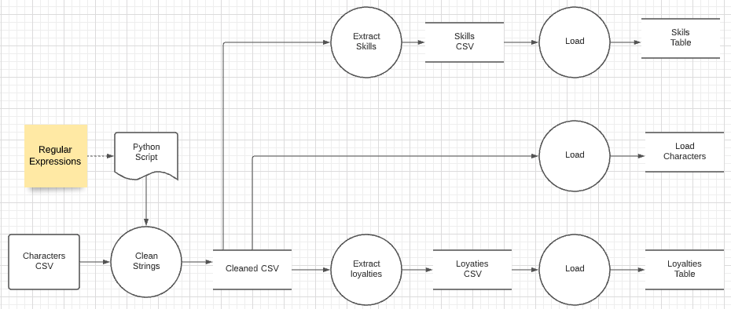
Data Flow
I downloaded the Harry Potter character set CSV file.
I had two cleanup problems.
The file contains some weird characters in strings, e.g. “9Ω" Fir dragon heartstring
There is a one-to-many relationship in columns marked with delimiters, e.g. Professor†of†Transfiguration†| Head of Gryffindor
I wrote a little Extract-Transform-Load (ETL) process. We will cover ETL in Module IV in the final part of the semester.
The next steps are to clean up the data in the RDB.

